Slide 1
DL3: Non-Local Self* Image Denoising
Related Work

Slide 2
Table of Contents
The problem
The types of solutions
Mathematical-based approaches
Deep Learning approaches: Supervised Image Denoising
Deep Learning approaches: Self-Supervised Image Denoising
Noise models and Datasets
Paper references

Slide 3
The Problem: Image Denoising
DEF: Given a noisy realization of an image, denoising is the problem of retrieving the clean underlying one by removing the graphical defects caused by noise.
Mathematically, given:
Z = Y + η
Z is the noisy observed image
Y is the clean underlying image
η is the noise perturbation
Provide:
Y’ ~ Y

Slide 4
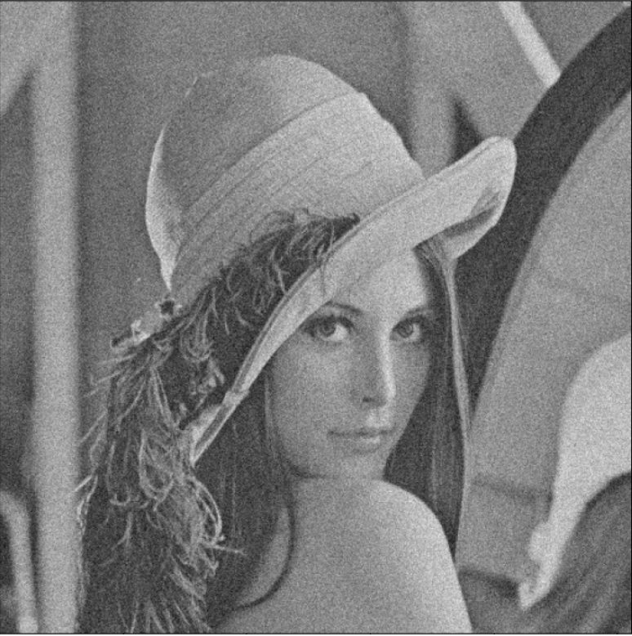
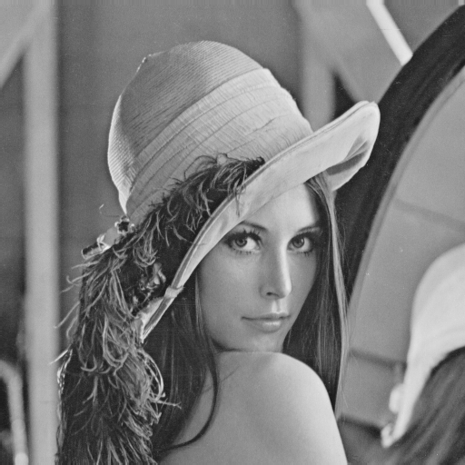

The Problem: Image Denoising
Z = Y + η
Y
Y’ ~ Y

Slide 5
The types of solutions
Statistical/Mathematical based solutions
Deep-Learning based solutions
  Supervised image denoising
  Self-Supervised image denoising

Slide 6
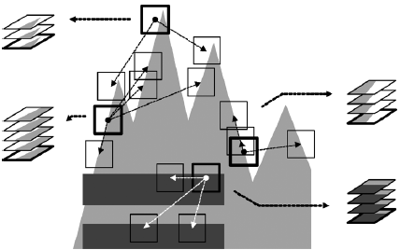
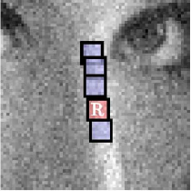
Statistical/Mathematical based solutions
These algorithms tackle the problem of producing a clean estimate of the underlying image by processing the noisy input one through the enforcement of mathematical priors, such as sparsity and self-similarity.
Methods that use sparsity and/or self-similarity priors:
NL-Means
BM3D
Methods that use advancements in statistics:
WNNM
Notes:
- NL-Means: They explain how denoising is achieved by averaging and move on by analysing 4 of the main methods used at the time for it, highlighting their drawbacks. Then they present their NL-means method which basically computes a weighted average of each pixel in the image after assigning weights to pixels in the neighborhood based on the similarity of their value with the processed one.
- BM3D: They achieve state-of-the-art denoising by utilizing grouping and collaborative filtering. In particular, grouping is done by Block Matching, thus they extract patches from the noisy image and group them together by calculating a distance between the referenced one and the processed one (typically the l2-norm is employed). While, collaborative filtering, is done by applying a linear 2D transform, then a shrinkage operation, such as hard-thresholding or Wiener filtering, and the inverse of the 2D transform.
- WNNM: This paper presents the Nuclear Norm Minimization method, pointing out at its limitations, namely the fact that every value is treated equally no matter the information it carries. It then proposes its new way of doing NNM: WNNM, which basically consists of applying a weighted sum with weights scaled properly to account for the quantity of information carried by each value taken in consideration. Finally, it presents a denoising procedure based on this method and shows the results.

Slide 7
Stat/Math based solutions’ problems
Although these methods work fairly well, achieving good levels of performance, they present the following problems:
They do not generalize or scale well enough
They require manual hyperparameter setting
They require a lot of computing resources in the denoising process

Slide 8
DL solutions: Supervised ID
Supervised image denoising methods involve the training of a Deep Neural Network using pairs of noisy and corresponding clean images to let the model learn the task of separating the noise from the underlying clean image.
The literature indicates 2 sub approaches to this type of solution:
DNN trained to produce in output directly the underlying clean image (FFDNet)
DNN trained to produce in output a map of the noise that is then elicited from the noisy image to retrieve the clean one (DnCNN)
Notes:
- FFDNet: They train a CNN to learn to output directly the clean image, still using BN in training. The novelty is their use of an invertible downsampling function they use to generate more input images and the addition of a noise level map to the input given to the NN.
- DnCNN: They train a CNN to learn a map of the noise which they remove from the noisy image to obtain the estimation of the clean one with a simple subtraction. For effective and efficient CNN training they use a combination of residual learning and batch normalization

Slide 9
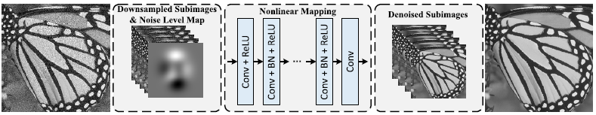
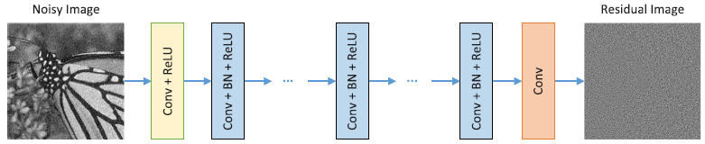
DL solutions: Supervised ID
FFDNet:
DnCNN:
Notes:
- FFDNet: They train a CNN to learn to output directly the clean image, still using BN in training. The novelty is their use of an invertible downsampling function they use to generate more input images and the addition of a noise level map to the input given to the NN.
- DnCNN: They train a CNN to learn a map of the noise which they remove from the noisy image to obtain the estimation of the clean one with a simple subtraction. For effective and efficient CNN training they use a combination of residual learning and batch normalization

Slide 10
Supervised ID solutions’ problems
Since supervised deep learning image denoising methods are data-driven and, thus, heavily rely on the quality and quantity of training data, they are able to produce the best state-of-the-art results for the task.
However, the critical problem they face is the acquisition of such data. It is indeed particularly difficult to obtain absolutely clean images in real-world applications, which limits the usability of such methods.

Slide 11
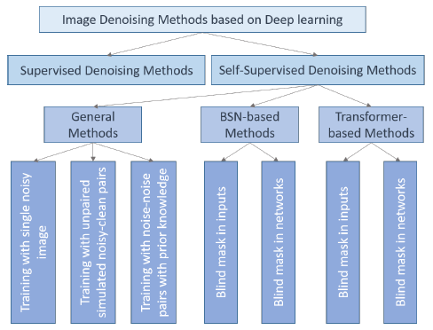
DL solutions: Self-Supervised ID
Self-supervised image denoising methods involve the training of a Deep Neural Network using only the observations of a set of noisy images, thus eliciting the requirements for clean image acquisition.
All the methods of this family can be reconducted to 1 of these 2 sub-cathegories, based on the approach used for denoising:
General Methods
BSN-Based Methods
Notes:
(following the work of Zhang et al in the paper: «Unleashing the power of self-supervised image denoising: a comprehensive review»)

Slide 12

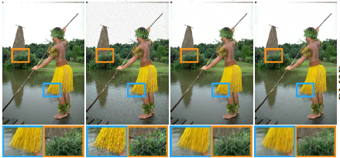
The Noise2Noise ‘‘incident’’
Noise2Noise is one of the first proposed methods that doesn’t imply the use of clean-noisy image pairs when training a NN for image denoising.
By arguing about the minimization of the loss function, they show how the use of clean images during training is not necessary so long as we have pairs of noisy realizations of the same clean scene, corrupted by zero-mean noise.
Notes:
Noise2Noise (Learning image restoration without clean data, Lehtinen et al. 2018). By applying some basilar statistic reasoning, the authors find that there is no need to have noisy-clean image pairs for training a NN to solve the denoising task. The authors also reason on how different types of loss functions can be utilized on different kinds of denoising problems (the focus is on L2, L1, L0 and Lhdr).
L2 -> mean
L1 -> median
L0 -> complicated .-.

Slide 13
General SSID methods
Among SSID methods, the ones that fall under this cathegory are the ones that follow the definition of SSID without adding any particular requirements or following precise architectures.
The general SSID methods can be divided into 3 sub-cathegories based on the types of inputs they utilize during training:
Artificially generated noisy-noisy image pairs
Single noisy images
Unpaired noisy-clean images (*)
Notes:
(following the work of Zhang et al in the paper: «Unleashing the power of self-supervised image denoising: a comprehensive review»)

Slide 14
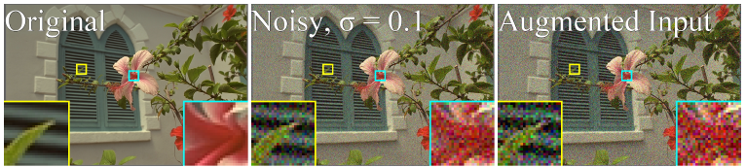
Artificially generated noisy-noisy pairs methods
Methods falling under this sub-cathegory are the ones that, given a noisy image in input, they generate a new noisy version of the same scene by adding more noise to the input. Then use the artificial noisy-noisy pair to train a neural network to perform the denoising task following the work of N2N.

Slide 15
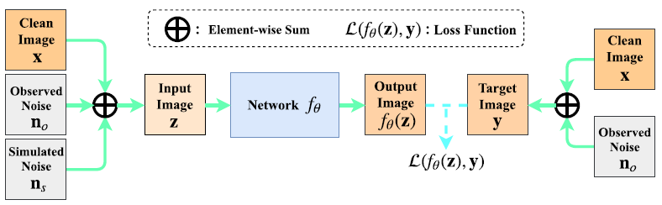
Artificially generated noisy-noisy pairs methods
The papers following this framework are the following:
NAC (Noisy-as-clean: Learning self-supervised denoising from corrupted image. Xu et al. 2020.)
  ASM: Noise value is weak in comparison to the value of the clean signal
  LIM: Necessity of knowing the noise model and level in advance + poor performances for strong noise
Notes:
- NAC (Noisy-As-Clean: learning self-supervised denoising from corrupted image, Xu et al. 2020). This paper proposes a method to train, in a self-supervised way, NNs that achieved effective results when employed for supervised denoising (DnCNN and ResNet). The method consists of producing a new corrupted image z from the noisy observation y, by adding a synthetic noise n that is as close as possible to the noise present in y. Then, train the network with z as input and y as GT. Since the noise is assumed to be low in value compared to the signal itself, the NN effectively learns to remove the noise n from corrupted images.
- Noisier2Noise (Noisier2Noise: learning to denoise from unpaired noisy data, Moran et al. 2020). This paper presents a method for denoising that is similar to NAC, but allows to avoid training a NN for each image to denoise. The idea is, given the noise distribution from which the clean image is corrupted, generate a new noisy image by adding a new noise value drawn from this distribution. Then, train the NN to predict the noisy image from the artificial one given in input and, finally, recover the estimate of the clean image by doubling the network’s output and subtracting its input.

Slide 16
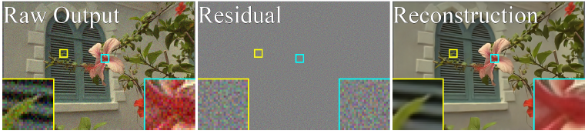
Artificially generated noisy-noisy pairs methods
Noisier2Noise (Noisier2noise: Learning to denoise from unpaired noisy data. Moran et al. 2020.)
  ASM: Noise distribution is known and should be able to extract samples from it
  LIM: Necessity of knowing the noise model, thus it struggles for blind denoising
Papers yet to read: R2R, IDR, Noise2Score
Notes:
- NAC (Noisy-As-Clean: learning self-supervised denoising from corrupted image, Xu et al. 2020). This paper proposes a method to train, in a self-supervised way, NNs that achieved effective results when employed for supervised denoising (DnCNN and ResNet). The method consists of producing a new corrupted image z from the noisy observation y, by adding a synthetic noise n that is as close as possible to the noise present in y. Then, train the network with z as input and y as GT. Since the noise is assumed to be low in value compared to the signal itself, the NN effectively learns to remove the noise n from corrupted images.
- Noisier2Noise (Noisier2Noise: learning to denoise from unpaired noisy data, Moran et al. 2020). This paper presents a method for denoising that is similar to NAC, but allows to avoid training a NN for each image to denoise. The idea is, given the noise distribution from which the clean image is corrupted, generate a new noisy image by adding a new noise value drawn from this distribution. Then, train the NN to predict the noisy image from the artificial one given in input and, finally, recover the estimate of the clean image by doubling the network’s output and subtracting its input.

Slide 17
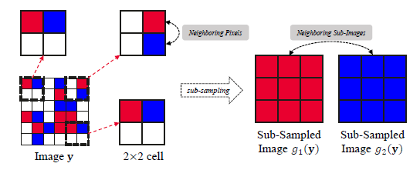
Single noisy images methods
Methods falling under this sub-cathegory utilize a denoising approach similar to the one of the previous sub-cathegory, but do not generate a new noisy version of the input image. Instead, they typically generate more images through subsampling operations or other types of decompositions.
Notes:
- GCBD basically uses noisy images to train a GAN to estimate the noise distribution and generate samples from it. Those samples are then applied to clean images to generate artificially (clean-noisy) image pairs employed in the training of a CNN for denoising.
- C2N trains a noise generator network G to create a realistic noise map n’ for a given clean image x, which is used to produce the noisy image y = x + n’. They then use a discriminator network D to try to distinguish the geneated noisy images from the real noisy images. Once the discriminator is constantly fooled, they use the noisy images generated from G to train a CNN for denoising.

Slide 18
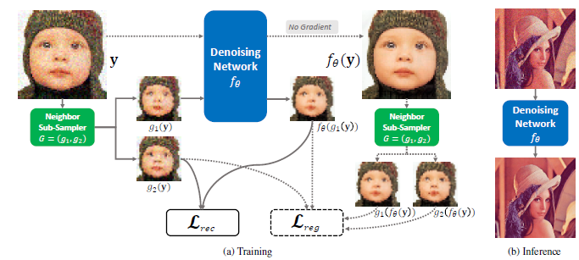
Single noisy images methods
The papers following this framework are the following:
Neighbor2Neighbor (Neighbor2Neighbor: self-supervised denoising from single noisy images, Huang et al. 2021.)
  ASM: There is no correlation between noise values in different positions
  LIM: Easily leads to over-smoothing + downsampling can destry structural continuity
Paper yet to read: CVF-SID
Notes:
- Neighbor2Neighbor (Neighbor2Neighbor: self-supervised denoising from single noisy images, Huang et al. 2021). This paper presents a method for training denoising NN in a self-supervised way. The framework is the following: from the input image, generate 2 images using a random sub-sampler and use one of them as input and the other as target. Over these 2, calculate the loss function which is composed of a reconstruction term, computed between the output and the noisy target, and a regularization term, that considers the difference of the GT pixel values between the sub-sampled noisy image pairs.

Slide 19
Unpaired noisy-clean images methods
These methods fall under the SSID cathegory as, even if they imply the use of clean images, they do not need to have also a noisy realization of the same underlying scene.
Methods that fall under this sub-cathegory are:
GCBD (Image blind denoising with generative adversarial network based noise modeling. Chen et al, 2018.)
C2N (C2n: Practical generative noise modeling for real-world denoising. Jang et al, 2021)
Notes:
- GCBD basically uses noisy images to train a GAN to estimate the noise distribution and generate samples from it. Those samples are then applied to clean images to generate artificially (clean-noisy) image pairs employed in the training of a CNN for denoising.
- C2N trains a noise generator network G to create a realistic noise map n’ for a given clean image x, which is used to produce the noisy image y = x + n’. They then use a discriminator network D to try to distinguish the geneated noisy images from the real noisy images. Once the discriminator is constantly fooled, they use the noisy images generated from G to train a CNN for denoising.

Slide 20
BSN-based SSID methods
Methods falling under this cathegory all imply the use of a Blind Spot Network during the denoising step.
A BSN is basically a method of denoising images that masks pixels to predict during training in order to teach a neural network to use the information coming from neighboring pixels to effectively predict the value of the masked ones.
The effectiveness of these kinds of solutions depends on the following assumptions:
The noise in the image is SPATIALLY INDEPENDENT and ZERO-MEAN
The image signal exhibits SPATIAL CORRELATION
Notes:
(following the work of Zhang et al in the paper: «Unleashing the power of self-supervised image denoising: a comprehensive review»)

Slide 21
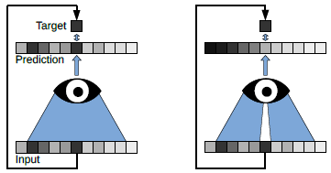
BSN-based SSID methods
These methods can be further divided into 2 sub-cathegories based on the way the mask strategy is applied:
Mask in input: they apply a specific mask to the input image that is later fed to the NN
Mask in network: they enforce the use of the mask by covering parts of the receptive field through the introduction of particular convolutional layers in the network’s architecture
Notes:
(following the work of Zhang et al in the paper: «Unleashing the power of self-supervised image denoising: a comprehensive review»)

Slide 22
Mask in input BSN methods
The papers following this framework are the following:
Noise2Void (Noise2Void: Learning denoising from single noisy images, Krull et al. 2019).
  LIM: Resource waste and loss of information + Performs poorly with structured noise that violates the assumption of statistical independence
PN2V (Probabilistic Noise2Void: unsupervised content-aware denoising, Krull et al. 2020)
  LIM: It needs a high quality noise model to work + Can perform poorly on real noisy images since the noise doesn’t necessarily follow a Poisson-Gaussian or Histogram based model + Need for the acquisition of calibration data.
FUPN2V (Fully unsupervised probabilistic noise2void, Prakash et al. 2020).
  LIM: Needs the acquisition of calibration data for optimal results + Without calibration data, the GMM fits well for lower signals but fails for higher ones.
Notes:
- N2V(Noise2Void: Learning denoising from single noisy images, Krull et al. 2019). The idea of the method is to train a CNN to effectively predict the value of each pixel by removing/masking its value from the receptive field taken from the noisy observation. The idea is that during training, random pixels of 64x64 patches of the image are masked by substitution with other adjacent ones. To prevent the NN from learning the identity-function each pixel is substituted by a random one in the neighborhood.
- PN2V ( Probabilistic Noise2Void: unsupervised content-aware denoising, Krull et al. 2020 ). The method is an extension of N2V in which the authors build on the idea of masking the processed pixel, but instead of predicting a value for it, they train the NN to output a probability distribution that is as close as possible to the one of the input image. Then draw K samples from it and average them to find the best denoised pixel value estimation.
- FUPN2V ( Fully unsupervised probabilistic noise2void, Prakash et al. 2020 ). The paper expands on the PN2V method by removing the histogram based noise model and substituting it with a Gaussian Mixture Model that describes the distribution of a noisy observation as the weighted average of K gaussian distributions. It also proposes a way to make PN2V fully unsupervised without the need to rely on calibration data. This is done by applying N2V and taking the result as a pseudo GT image, that is later used to construct the appropriate noise model.

Slide 23
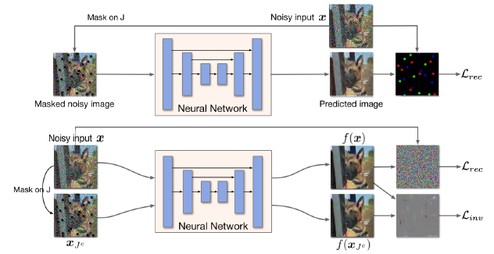
Mask in input BSN methods
The papers following this framework are the following:
Noise2Self (Noise2Self: Blind denoising by self-supervision, Batson et al. 2019).
  LIM: Difficult to find the right J-invariant function + Loss of information
Noise2Same (Noise2Same, optimizing a self-supervised bound for image denoising, Xie et al. 2020).
  LIM: (?)
Notes:
- N2S ( Noise2Self: Blind denoising by self-supervision, Batson et al. 2019 ). The paper proposed the idea of training a NN to minimize the self-supervised loss: E[|| f(x) – x ||^2], where f is a J-invariant function. Among all the possible J-invariant functions, the NN chooses the one that best suits the image to denoise by setting its parameters during training.
- Noise2Same (Noise2Same, optimizing a self-supervised bound for image denoising, Xie et al. 2020). This paper analyses previous research in self-supervised denoising methods and the way they utilize the J-invariant property of their loss functions. It points out how respecting the strictly J-invariant property leads to loss of information on the image, thus having negative effects on the denoising result. It then proposes a new loss function for training self-supervised NN for denoising that uses a term which prevents the network to learn the identity function without imposing any requirement on the learned function.

Slide 24
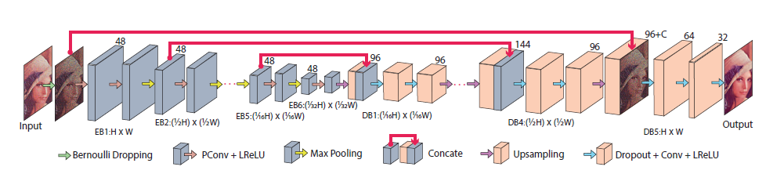
Mask in input BSN methods
The papers following this framework are the following:
S2S (Self2Self with dropout: learning self-supervised denoising from single image, Quan et al. 2020).
  LIM: Loss of information
Paper yet to read: Blind2Unblind
Notes:
-Self2Self (Self2Self with dropout: learning self-supervised denoising from single image, Quan et al. 2020). This paper is the first to really propose the self-supervised denoising utilizing only 1 single noisy image. They artificially produce noisy image pairs from the input one by applying a random Bernoulli distribution and use these pairs to train a NN (encoder-decoder like) to learn the denoising function. The novelty of the method is that they introduce denoising in every step of image denoising, thus generating “different networks in one”, and ensenbling them together at the end to achieve a better overall result.

Slide 25
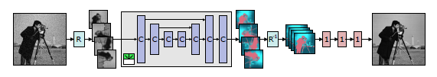
Mask in network BSN methods
The papers following this framework are the following:
HQ (High Quality self-supervised deep image denoising, Laine et al. 2019).
  ASM: The clean value of a pixel i depends on the noisy measurement of that pixel and on the context of neighboring pixels + Necessity of knowing the noise model.
  LIM: Necessity of knowing the noise model + Limited scalability to larger images and different noise patterns due to the large numbers of parameters
Notes:
- HQ (High Quality self-supervised deep image denoising, Laine et al. 2019). This paper presents a method to train a NN for self-supervised image denoising by utilizing a series of convolutions over half planes to simulate the effects of a blind spot network by construction. In practice, the method consists of a series of convolutional, upsampling and downsampling layers that slows the network to predict the value of a pixel directly from the neighborhood, avoiding to know the value of the central one.

Slide 26
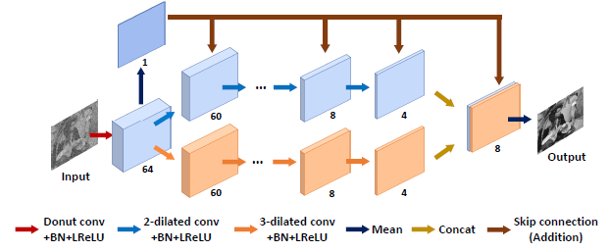
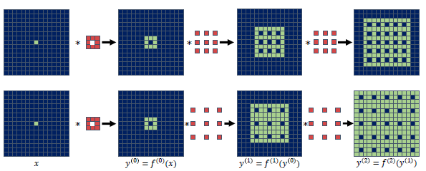
Mask in network BSN methods
The papers following this framework are the following:
N2K (Noise2Kernel: adaptive self-supervised blind denoising using a dilated convolutional kernel architecture, Lee et al. 2022).
  LIM: (?)
Notes:
- N2K (Noise2Kernel: adaptive self-supervised blind denoising using a dilated convolutional kernel architecture, Lee et al. 2022). This paper presents a new network for self-supervised denoising built with a series of donut-based kernel and dilated convolutional layers that enforces the learning of a J-invariant function. Moreover, the authors introduce a new loss function that is more robust to outliers’ values, since it uses a constraint that takes into account the difference between the prediction and the real image.

Slide 27
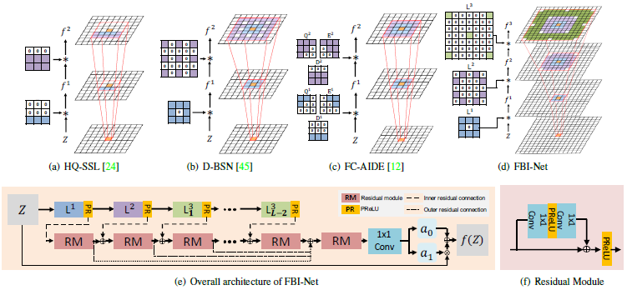
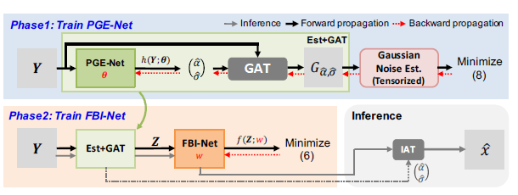
Mask in network BSN methods
The papers following this framework are the following:
FBI-Denoiser (FBI-Denoiser: fast blind image denoiser for Poisson-Gaussian noise, Byun et al. 2021).
  LIM: Poisson-Gaussian noise model might not be the best one for describing the noise of every real noisy image
Notes:
- FBI-Denoiser (FBI-Denoiser: fast blind image denoiser for Poisson-Gaussian noise, Byun et al. 2021). The paper tackles the problem of real world image self-supervised denoising by introducing a new method composed of the following 2 steps. First, a NN (PGE-Net) is trained to produce a good estimation of the noise parameters. Second, based on this noise estimation, a new BSN is employed to learn the denoising function. Note that the real world noise is modelled with a Poisson-Gaussian distribution.
Papers to read: DBSN, AP-BSN, MM-BSN, Spatially-adaptive self-supervised learning

Slide 28
Tansformer-based SSID methods
The methods falling under this cathegory are the ones that imply the use of a Transformer, namely a computational unit that performs particular transformations over the input image that aim to fuse local and global features to enhance noise extraction.
In the literature, these are new approaches, so far as I know the following could be interesting papers:
Self-supervised image denoising for real-world images with context-aware transformer, Zhang et al.
Local and global blind-patch network for self-supervised real-world denoising , Wang et al.
Notes:
(following the work of Zhang et al in the paper: «Unleashing the power of self-supervised image denoising: a comprehensive review»)

Slide 29
Noise models and Datasets
Most, if not all, of the self-supervised image denoising methods seen make assumptions on the type of noise that affects the image to denoise. For such reason, while reading these papers, I’ve compiled a table that shows for which type of noise model each seen method has been tested.
Different datasets are emplyed for training all these method, but among these I’ve find some recurrency. In particular, the most used ones are:
BSD (Berkeley Segmentation Dataset)
Set5/12/14
RNI6/15
Notes:
For a better analysis of all the datasets seen, I remind to the work of Zhang et al in the paper: «Unleashing the power of self-supervised image denoising: a comprehensive review»

Slide 30
Thesis ideas?
Ideas I’ve came up with while reading:
What if I train something similar to S2S, but trying to enforce the self-similarity prior before the Bernoulli sampling?
Could I build the subsampler for NBR2NBR that enforces in some way the self-similarity prior?
In the case of mask in input methods (such as N2V), could I build a mask that enforces the self-similarity prior? For example enforcing the substitution of a masked pixel with the central pixel of the most similar patch?

Slide 31
Paper references
Jingwen Chen, Jiawei Chen, Hongyang Chao, and Ming Yang. Image blind denoising with generative adversarial network based noise modeling. In Proceedings of the IEEE Conference on Computer Vision and Pattern Recognition, pages 3155–3164, 2018.
Geonwoon Jang, Wooseok Lee, Sanghyun Son, and Kyoung Mu Lee. C2n: Practical generative noise modeling for real-world denoising. In Proceedings of the IEEE/CVF International Conference on Computer Vision, pages 2350–2359, 2021.
Nick Moran, Dan Schmidt, Yu Zhong, and Patrick Coady. Noisier2noise: Learning to denoise from unpaired noisy data. In Proceedings of the IEEE/CVF Conference on Computer Vision and Pattern Recognition, pages 12064–12072, 2020.
Jun Xu, Yuan Huang, Ming-Ming Cheng, Li Liu, Fan Zhu, Zhou Xu, and Ling Shao. Noisy-as-clean: Learning self-supervised denoising from corrupted image. IEEE Transactions on Image Processing, 29:9316–9329, 2020.
Tao Huang, Songjiang Li, Xu Jia, Huchuan Lu, and Jianzhuang Liu. Neighbor2neighbor: Self-supervised denoising from single noisy images. In Proceedings of the IEEE/CVF Conference on Computer Vision and Pattern Recognition, pages 14781–14790, 2021.
Alexander Krull, Tim-Oliver Buchholz, and Florian Jug. Noise2voidlearning denoising from single noisy images. In Proceedings of the IEEE/CVF Conference on Computer Vision and Pattern Recognition, pages 2129–2137, 2019.
Alexander Krull, Tom´aˇs Viˇcar, Mangal Prakash, Manan Lalit, and Florian Jug. Probabilistic noise2void: Unsupervised content-aware denoising. Frontiers in Computer Science, 2:5, 2020.
Prakash Mangal, Lalit Manan, Pavel Tomancak, Alexander Krull, Florian Jug. Fully unsupervised probabilistic noise2void. In 2020 IEEE 17° international Symposium on Biomedical Imaging (ISBI), pages 154-158, 2020.

Slide 32
Paper references
Joshua Batson and Loic Royer. Noise2self: Blind denoising by selfsupervision. In International Conference on Machine Learning, pages 524–533. PMLR, 2019.
Yaochen Xie, Zhengyang Wang, and Shuiwang Ji. Noise2same: Optimizing a self-supervised bound for image denoising. Advances in Neural Information Processing Systems, 33:20320–20330, 2020.
Yuhui Quan, Mingqin Chen, Tongyao Pang, and Hui Ji. Self2self with dropout: Learning self-supervised denoising from single image. In Proceedings of the IEEE/CVF Conference on Computer Vision and Pattern Recognition, pages 1890–1898, 2020.
Samuli Laine, Tero Karras, Jaakko Lehtinen, and Timo Aila. Highquality self-supervised deep image denoising. Advances in Neural Information Processing Systems, 32, 2019.
Lee, K.; Jeong,W-K.. Noise2Kernel: Adaptive Self-Supervised Blind Denoising Using a Dilated Convolutional Kernel Architecture. Sensors 2022, 22, 4255.
Jaeseok Byun, Sungmin Cha, and Taesup Moon. FBI-Denoiser: fast blind image denoiser for poisson-gaussian noise. In proceedings of the IEEE/CVF Conference on Computer Vision and Pattern Recognition, pages 5768-5777, 2021.
Dabov, K., Foi, A., Katkovnik, V., and Egiazarian, K. Image denoising by sparse 3-D transform-domain collaborative filtering. IEEE Trans. Image Process., 16(8):2080–2095, 2007.
A. Buades, B. Coll, and J.-M. Morel. A non-local algorithm for image denoising. In CVPR, 2005.
Shuhang Gu, Lei Zhang, Wangmeng Zuo, Xiangchu Feng. Weighted nuclear norm minimization with application to image denoising. In proceedings of the IEEE/CVF Conference on Computer Vision and Pattern Recognition, pages 2862-2869, 2014.

Slide 33
Paper references
K. Zhang, W. Zuo, Y. Chen, D. Meng, and L. Zhang. Beyond a gaussian denoiser: Residual learning of deep cnn for image denoising. IEEE Transactions on Image Processing, 26(7):3142–3155, 2017.
K. Zhang, W. Zuo, and L. Zhang. Ffdnet: Toward a fast and flexible solution for cnn based image denoising. IEEE Transactions on Image Processing, 2018.
Dan Zhang, Fangfang Zhou, Xiao Yang, Yuan Gu. Unleashing the power of self-supervised image denoising: a comprehensive review. arXiv preprint arXiv:2308.00247. (2023)

